Slide 1
Brain’s MRI scan segmentation
Final project
Tamar Klor- 2018/19

Slide 2
Using the SPM12 tool (which is generally used for adult’s brains) we get some good results of segmentation of a few parts of the brains.
The examples that will be shown are taken from patient no’ 54 and from the T2 coronal image.

Slide 3
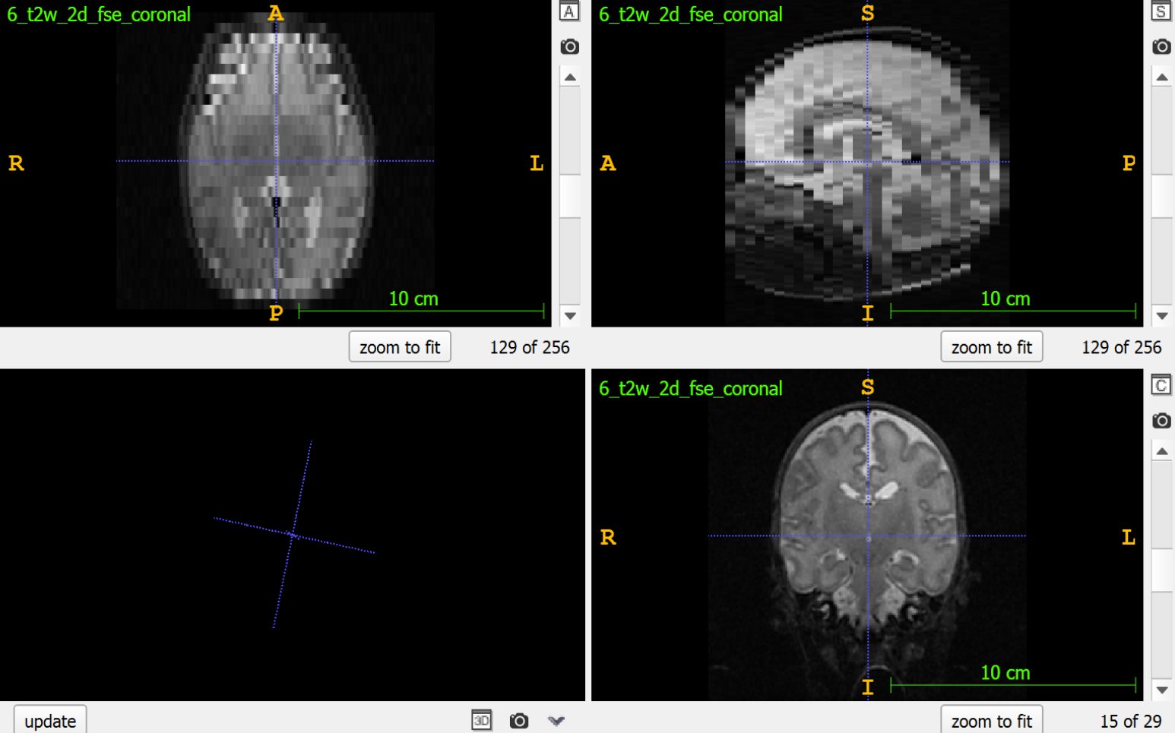
This is the original MRI image converted from dicom to nifti.

Slide 4
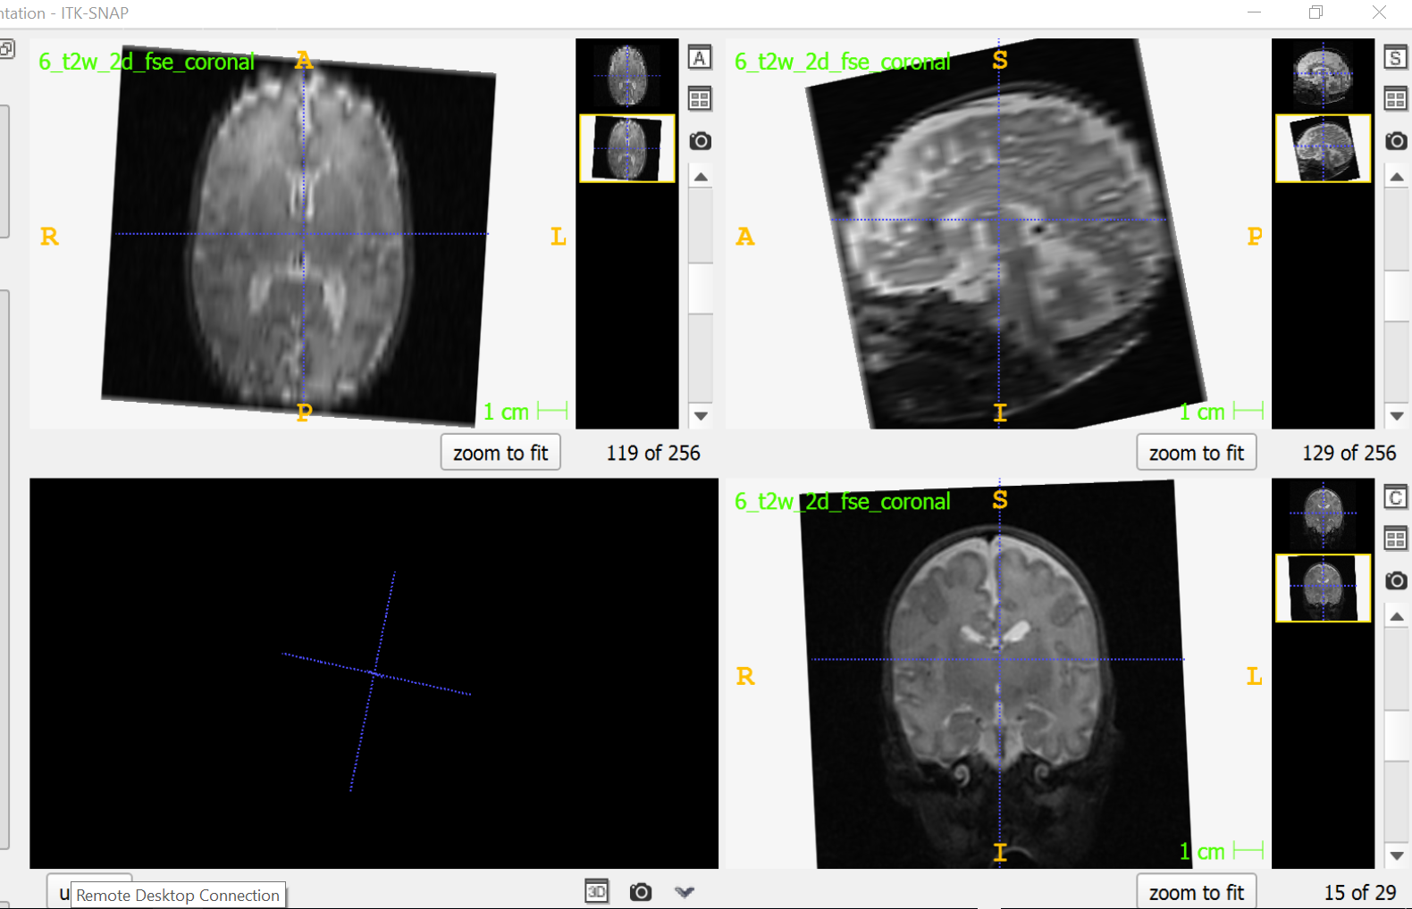
After alignment.

Slide 5
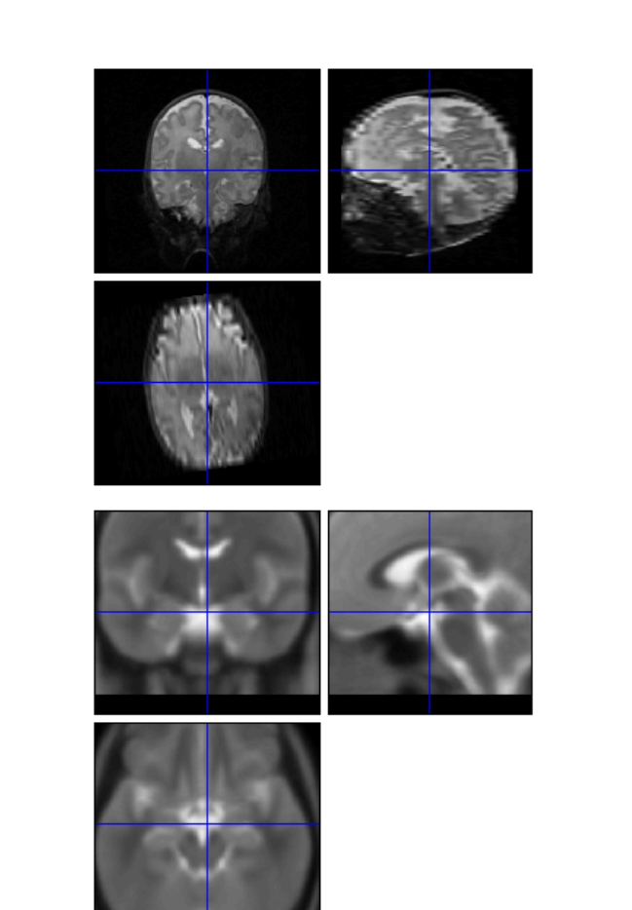
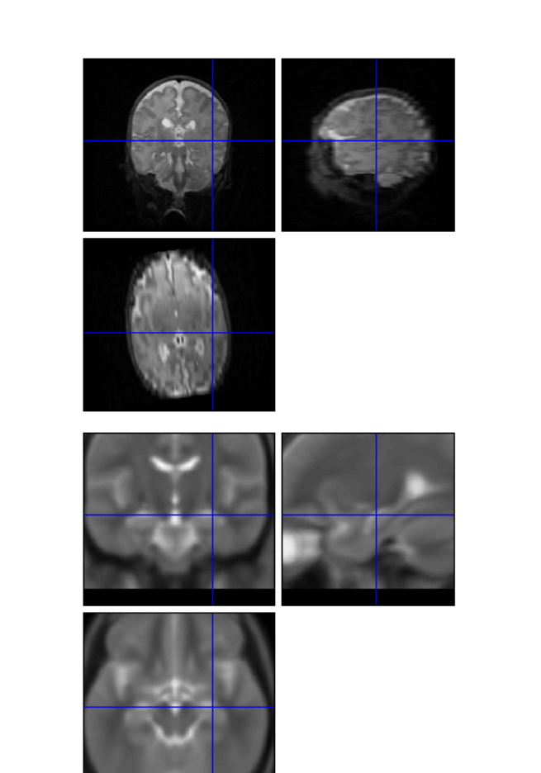
After the realignment:
Canonical images VS realigned images.

Slide 6
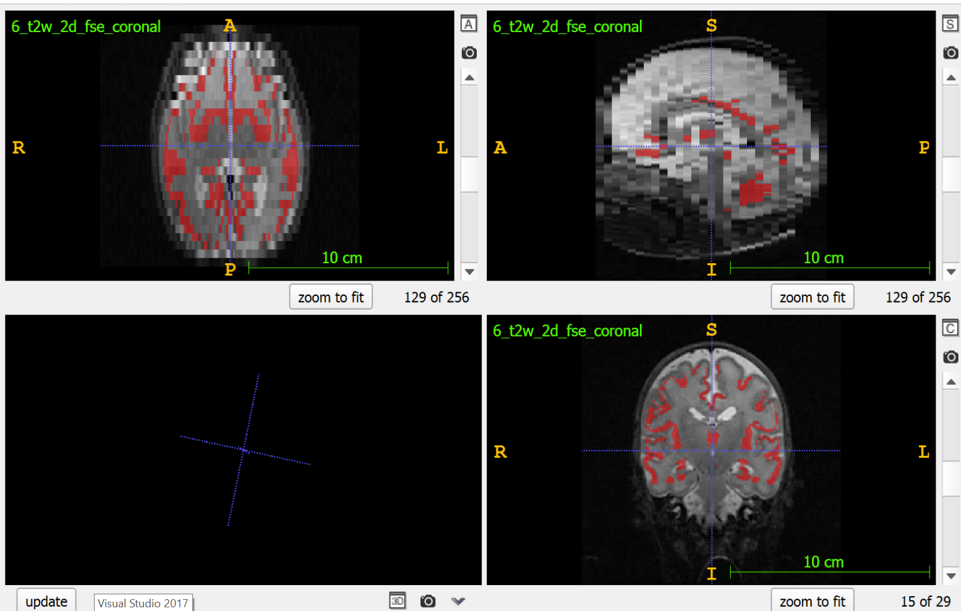
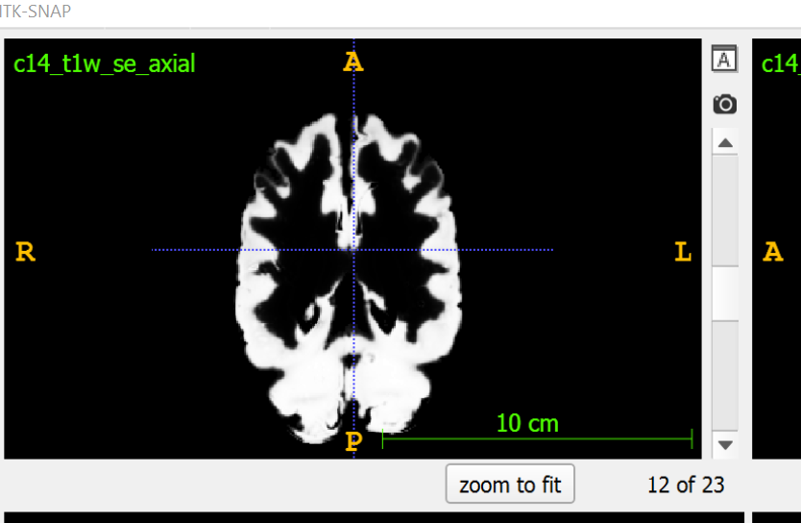
Gray matter

Slide 7
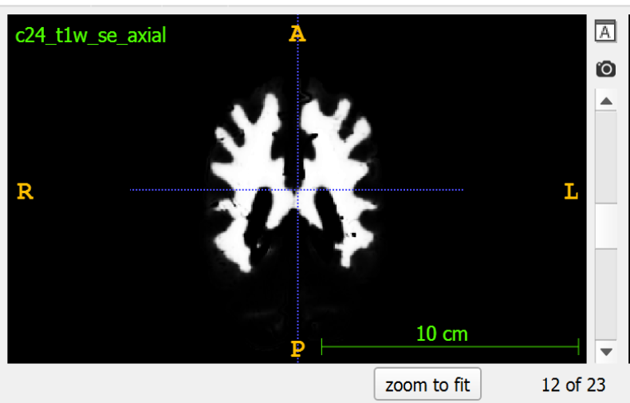
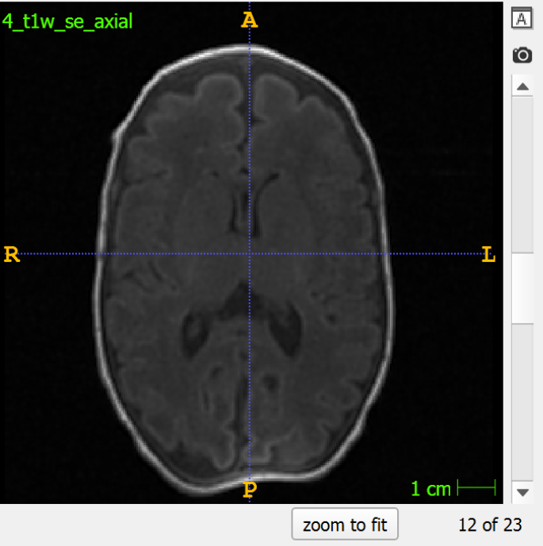
White matter

Slide 8
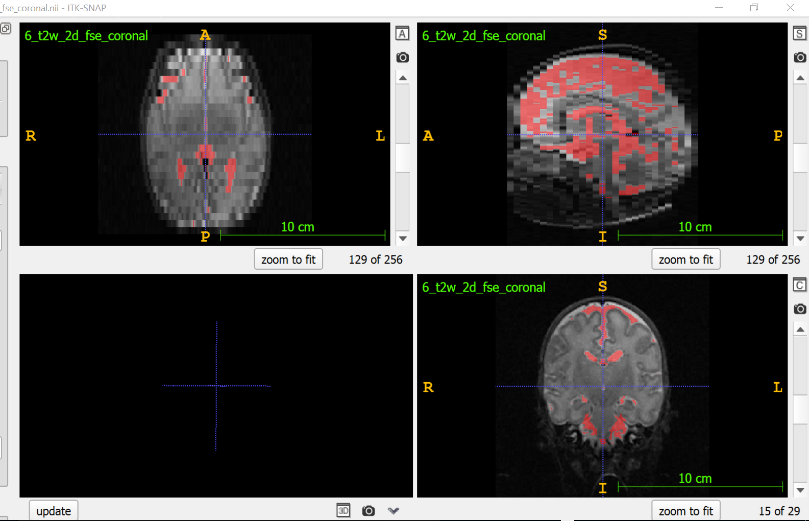
CSF

Slide 9
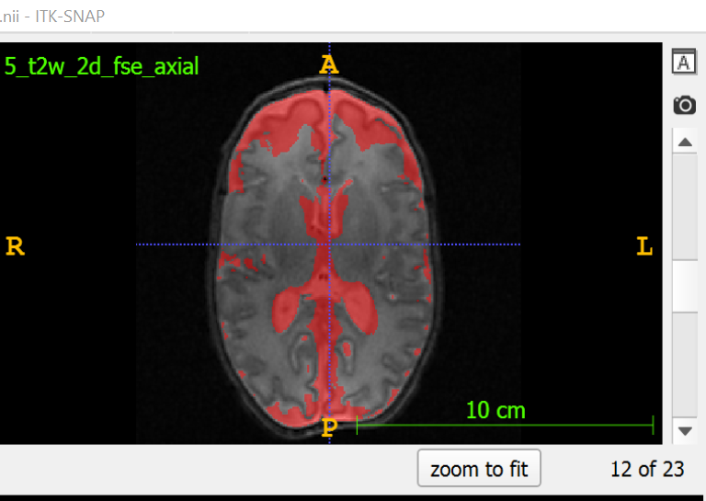
CSF of a T2 axial image

Slide 10
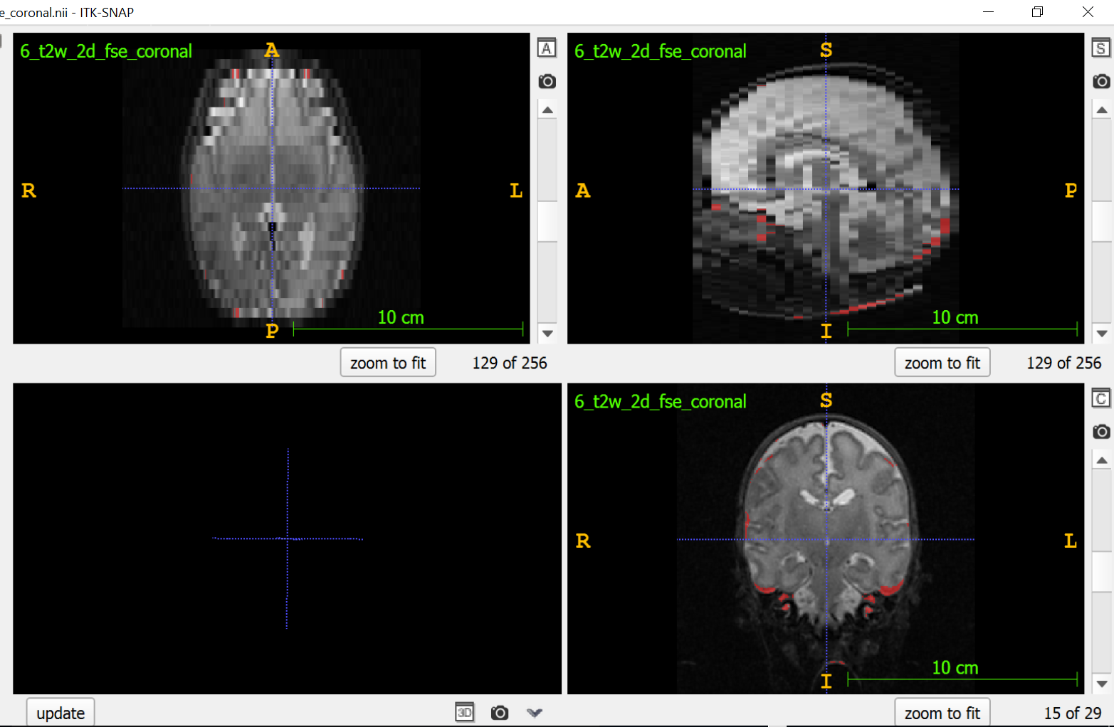
bone

Slide 11
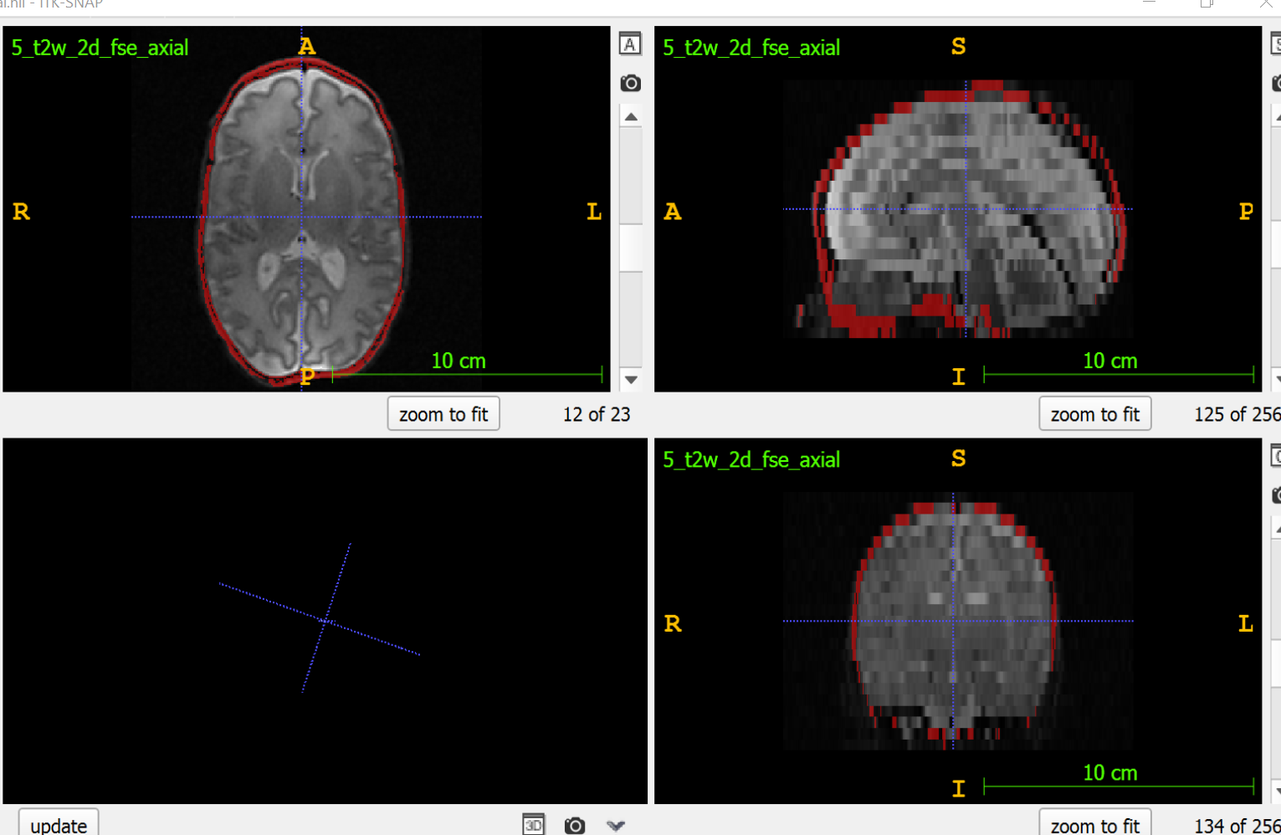
Bone of a T2 axial image

Slide 12
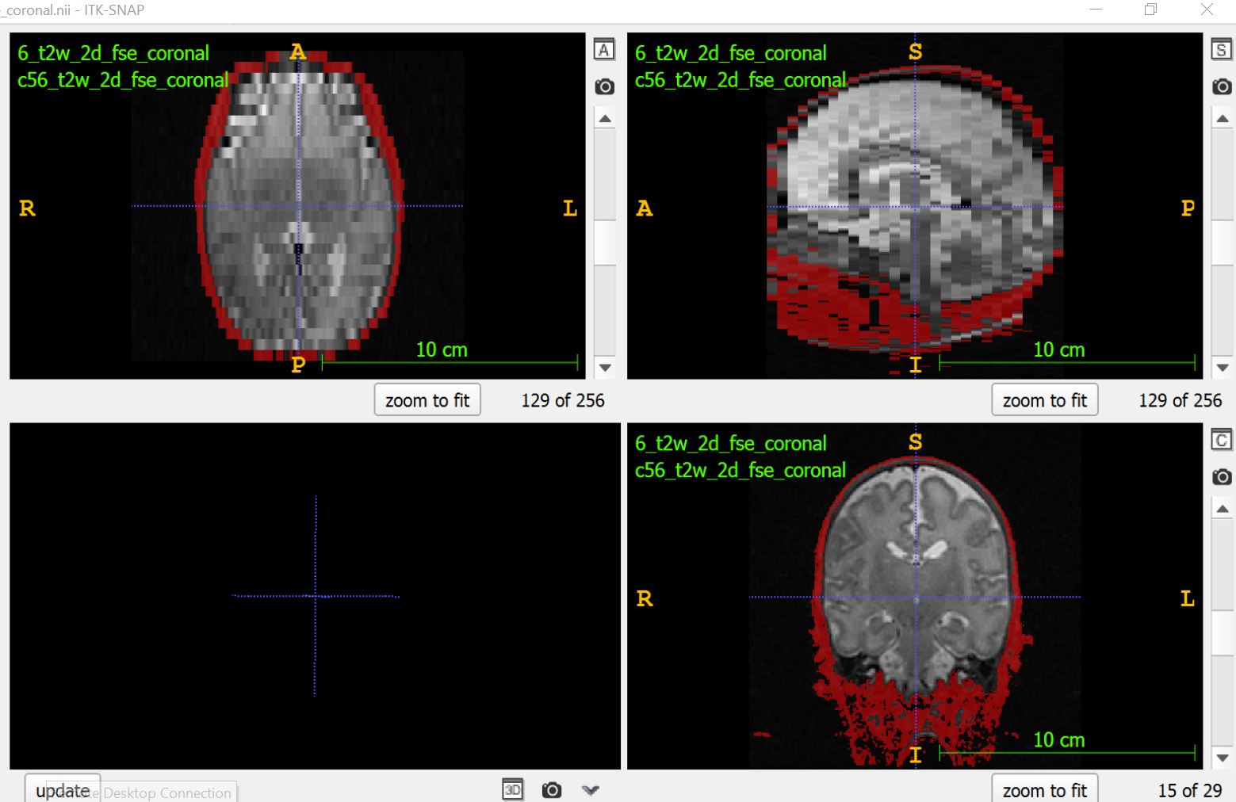
Soft tissue
Soft

Slide 13
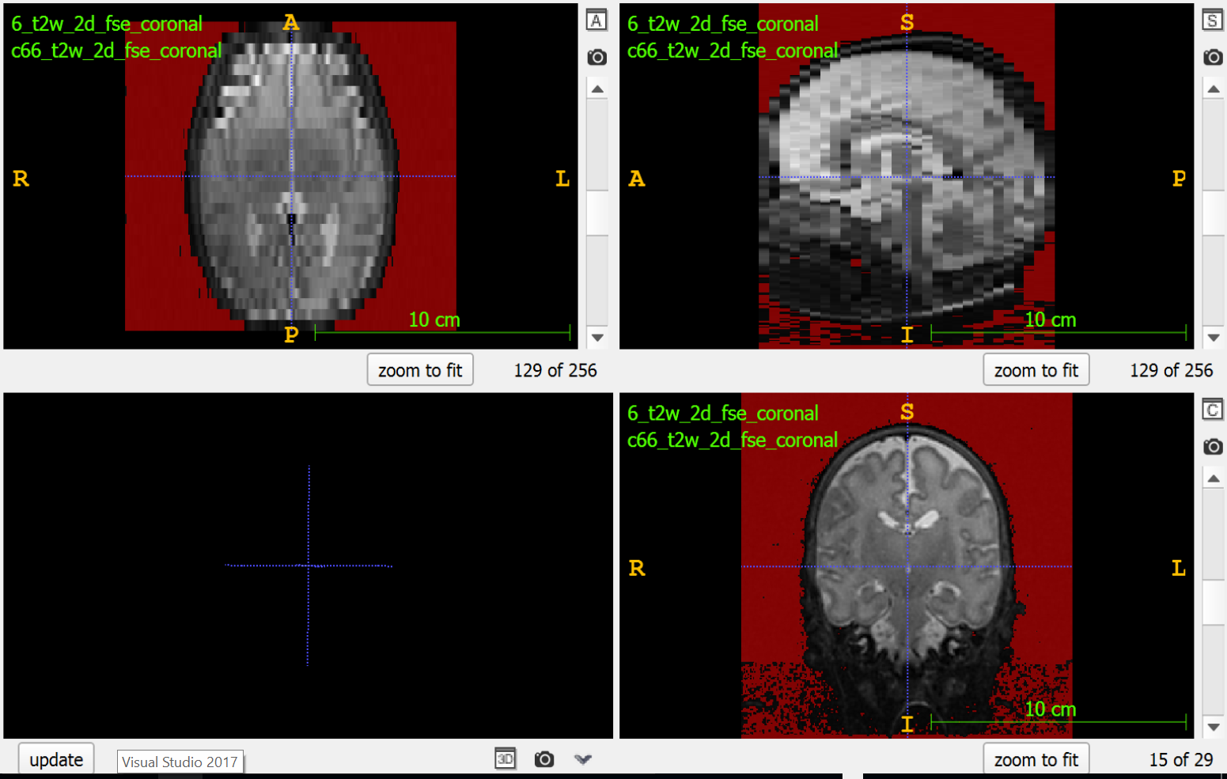
Air/ background

